Slide 1
Addressing Modes

Slide 2
introduction
Efficient software development for the mps familarity with addressig modes.
MOV inst. for data addressing modes: It transfers data between registers or between register and memory. Program memory addressing : jump
Tha data adressing modes: register, immediate , direct, register indirect, base-plus-index, register relative,and base relative-plus-index in the 8086-8028. the 80386 and above also include a scaled-index mode. The program memory addressing : relative, direct, indirect .
Operation of the stack memory:Push and pop instr.

Slide 3
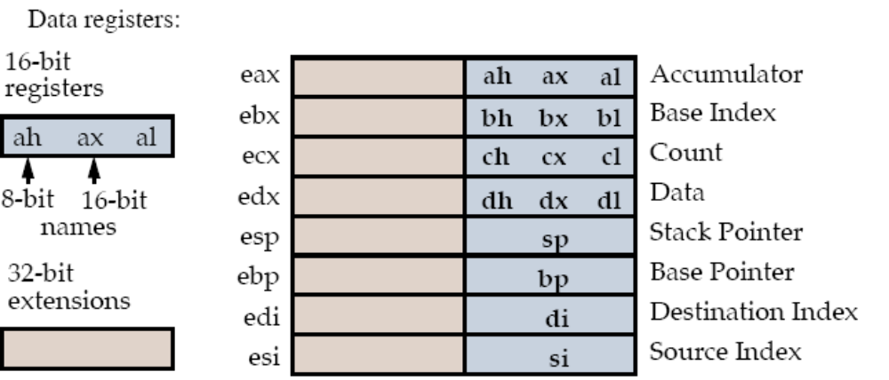

Slide 4
Data Addressing Modes
cover the data addressing modes using the mov instruction. ( see the figure 3.1on page 56)
Data movement instructions move data (bytes, words and doublewords) between registers
and between registers and memory.
MOV AX , BX
copies the word Content of the BX into AX
BX source, AX destination (operands). MOV opcode (operation code)
The source never changes but the destination changes.
Only the movs (strings) instruction can have both operands in memory.
Most data transfer instructions do not change the EFLAGS register.

Slide 5
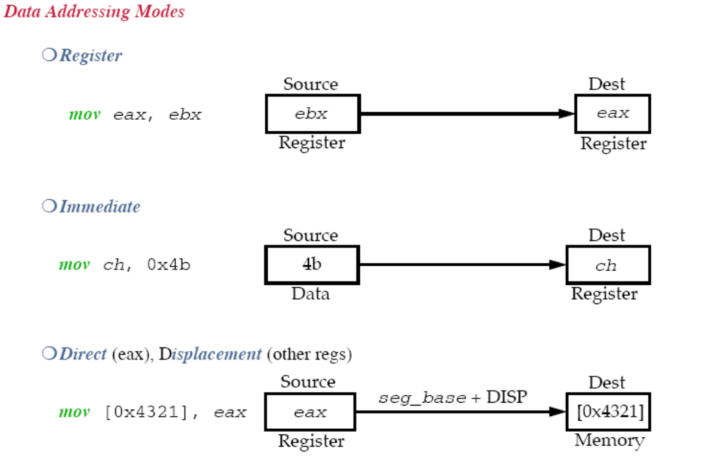

Slide 6
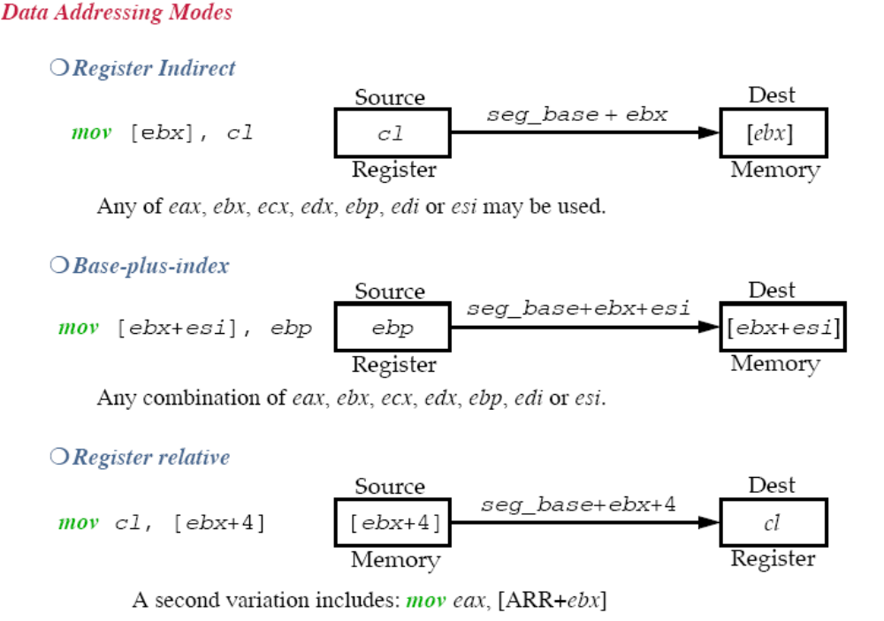

Slide 7
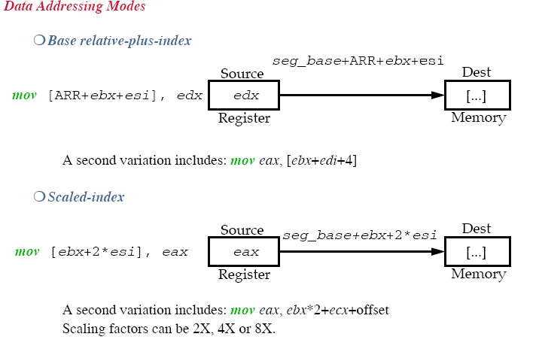

Slide 8
Data Addressing Modes
Register addressing
Note: mov really COPIES data from the source to destination register.
􀁑 Never mix an 16-bit register with a 32-bit, etc.
For example
mov eax, bx ;ERROR: NOT permitted.
􀁑 None of the mov instructions affect the EFLAGS register. Using a segment to segment register MOV instruction is not allowed. For example
Mov cs, ds
See the table 3.1and fig 3.3 on page 59
Immediate addressing: it transfers a copy of the immediate data into a register or memory location.
The value of the operand is given as a constant in the instruction stream.
mov eax, 0x12345 see the fig 3.4 on p60
In the 80386 through the p4 the immediate data can be a double word data.
􀁑 Use b for binary, q for octal and nothing for decimal.
􀁑 ASCII data requires a set of apostrophes:
mov eax, ‘A’ ;Moves ASCII value 0x41 into eax.

Slide 9
Register and immediate addressing example:
mov eax, 0
mov ebx, 0x0000
mov ecx, 0
mov esi, eax
Direct addressing:
Transfers data between memory location and al, ax and eax.
Usually encoded in 3 bytes, sometime 4:
mov al, DATA1 ;Copies a byte from DATA1.
mov al, [1234h] ;
mov al, ds:[1234h9]
mov DATA2, ax ;Copies a word to DATA2.

Slide 10
Displacement:
Displacement instructions are encoded with up to 7 bytes (32 bit register and a 32 bit
displacement).
Direct and displacement addressing example:
Note: Direct addressing (using al) requires 3 bytes to encode while Displacement
(using bx) requires 4.
mov cl, DATA1 ;Copies a byte from DATA1.
mov edi, SUM ;Copies a doubleword from SUM.

Slide 11
Register Indirect addressing:
Offset stored in a register (bp,bx,dı,sı) is added to the segment register.
The memory to memory mov is allowed with string instructions.
Any register EXCEPT esp for the 80386 and up.
For eax, ebx, ecx, edx, edi and esi: The data segment is the default.
For ebp: The stack segment is the default.
Some versions of register indirect require special assembler directives byte, word,
or dword
Use:
mov ecx, [ebx]
Does [edi] address a byte, a word or a double-word?
mov al, [edi] ;Clearly a byte-sized move.
mov [edi], 0x10 ;Ambiguous, assembler can’t size.
mov byte [edi], 0x10 ;A byte transfer.

Slide 12
Base-Plus-Index addressing:
Effective address computed as:
seg_base + base + index.
Base registers: Holds starting location of an array.
􀁑 ebp (stack)
􀁑 ebx (data)
􀁑 Any 32-bit register except esp.
Index registers: Holds offset location.
􀁑 edi
􀁑 esi
􀁑 Any 32-bit register except esp.
mov dl, [eax+ebx] ;EAX as base, EBX as index.
mov ecx,[ebx+edi] ;Data segment copy.
mov ch, [ebp+esi] ;Stack segment copy.

Slide 13
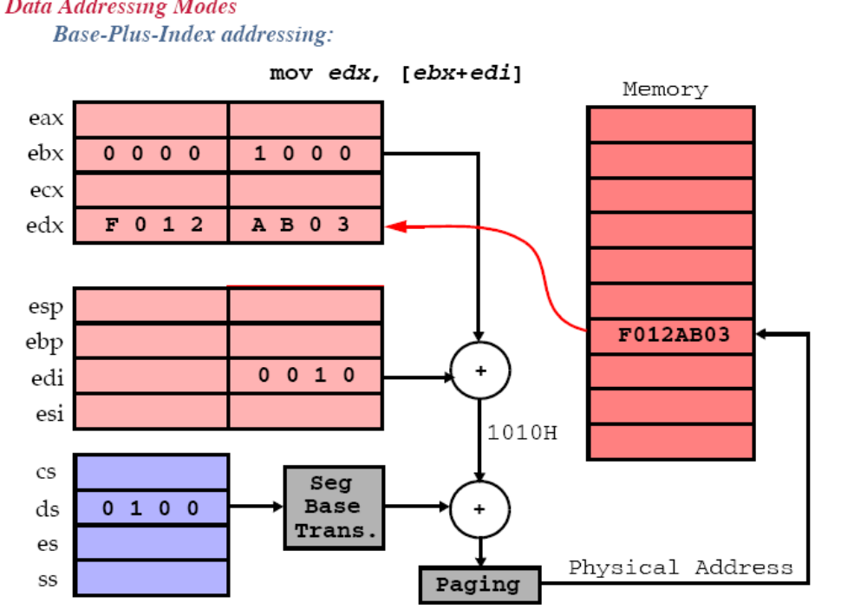

Slide 14
Register Relative addressing:
Effective address computed as:
the data in segment are addressed by adding the displacement to the contents of a base or an index register
seg_base + base or index(bp,bx,dı,sı) + constant.
Same default segment rules apply with respect to ebp, ebx, edi and esi. Bp addresses the stack segment and bx,dı,sı adress the data segment.
mov edx, [LIST+esi+2] ;Both LIST and 2 are constants.
mov eax, [ebx+1000H] ;Data segment copy.
mov edx, [LIST+esi-2] ;Subtraction.
Displacement constant is any 32-bit signed value (in the 80386 and above) .
Base Relative-Plus-Index addressing:
Effective address computed as:
seg_base + base + index + constant.
Designed to be used as a mechanism to address a two-dimensional array. (Suppose that a file of many records exists in a memory. Disp. Addresses the file , the base reg. addresses a record, the index reg. Addresses an element of the record. )
mov [LIST+ebp+esi+4], dh ;Stack segment copy.
mov dh, [ebx+edi+20H] ;Data segment copy.
mov ax, [FILE+ebx+edi] ;Constant is FILE.
mov eax, [FILE+ebx+ecx+2] ;32-bit transfer.
mov eax, FILE[ebx+ecx+2] ;32-bit transfer.

Slide 15
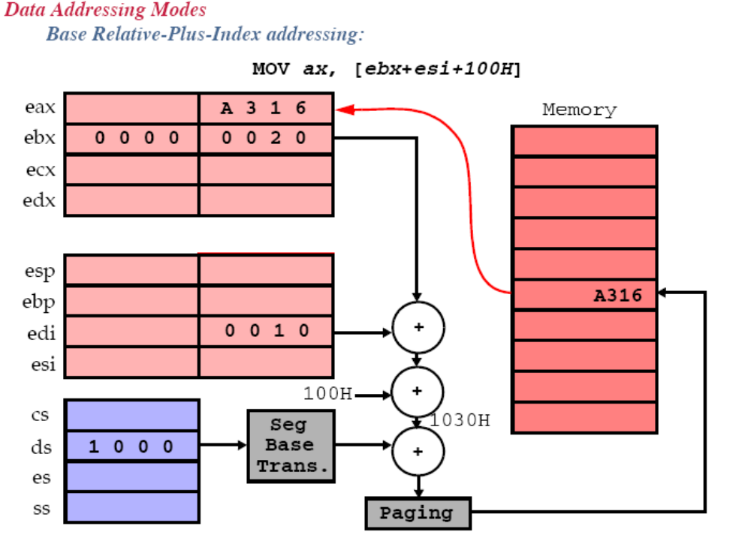

Slide 16
Scaled-Index addressing:
Effective address computed as:
seg_base + base + constant*index.
The scaling factor (constant) can 1x,2x,4x,8x
Some examples:
mov eax, [ebx+4*ecx] ;Data segment DWORD copy.
mov [eax+2*edi-100H], cx; copies cx into the DS mem. Loc. addressed by eax+e*edi-100H
mov eax, array[4*ecx]; copies the DW content of DS mem. loc. addressed by array+4*ecx

Slide 17
Code Memory-Addressing Modes
Used in jmp and call instructions.
Three forms:
Direct, Relative, Indirect
Direct
Absolute jump address is stored in the instruction following the opcode.
If a program jumps to memory location 10000h for the next instruction, the adress 10000h is stored following the opcode in the memory.

Slide 18
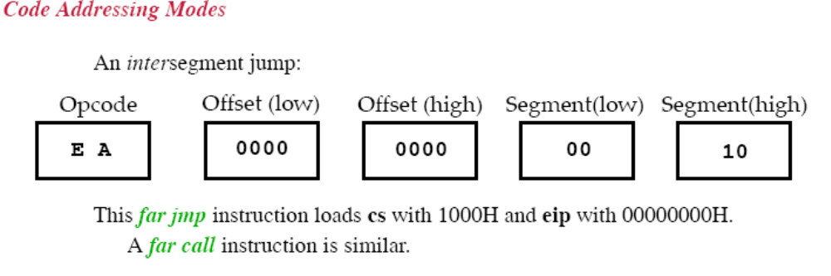
Direct Program Memory Addressing
JMP [10000H]
A direct jump is often called a far jump because it can jump to any memory location.

Slide 19
Relative Program Memory Addressing
Relative means “relative to the IP”.
A displacement is added to the IP register.
This constant is encoded into the instruction itself, as above.
Intrasegment jumps:
  Short jumps use a 1-byte signed displacement. (+127, -128)
  Near jumps use a 2-byte signed displacement. (+,- 32Kbytes)
The assembler usually computes the displacement and selects the appropriate form.
10000 eb
10001 02 jmp [2]
10002
10003
10004

Slide 20
Indirect Program Memory Addressing
Jump location is specified by a register.
There are three forms:
Register:
Any register can be used: eax, ebx, ecx, edx, esp, ebp, edi or esi.
Register Indirect:
Any relative register [bp], [bx], [di], or [si]
Register Relative:
Any relative register with a displacement
Some examples
jmp eax ; Jump within the code seg.
jmp [ebx] ; Jump to the current code segment location addressed by ebx
jmp [edi+2]
jmp TABLE[bx] ; Jump table.

Slide 21
STACK MEMORY adressing modes
The stack is used to hold temporary variables and stores return addresses for procedures. A LIFO (Last-in, First-out) policy is used.
push and pop instructions are used to manipulate it.(8086-286 word never bytes, 80386 word , doubleword))
call and ret also refer to the stack implicitly.
Two registers maintain the stack, esp and ss.
Push: High Order bits -> SS:[SP-1]
Low order bits->SS:[SP-2]
Sp=SP-2
Pop: SS:[SP]->low order bits
SS:[SP+1]->high order bits
sp=SP+2
See figure 3.17 on page 80.

Slide 22
Data may be pushed from any of the registers or segment registers.
Data may be popped into any register except cs.
popfd ;Pop doubleword for stack to EFLAG.
pUsh ax, pop ax
pop cs; illegal
pushfd ;Pushes EFLAG register.
push 1234H ;Pushes 1234H.
push word ptr [bx] ;Pushes double word in data seg.
pushad ;eax,ecx,edx,ebx,esp,ebp,esi,edi; (except segment registers)
pop eax ;Pops 4 bytes.
The pusha and popa instructions either push or pop all of the registers, except the segment register.
Example 3.14

